Slide 1
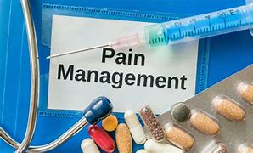

Slide 2
Pain Management
Objectives
Describe pain.
Explain the approved pain assessment tools.
Summarize key elements of successful pain management, including pharmacologic and non-pharmacologic interventions.

Slide 3
Pain Management
The Joint Commission
Identify pain assessment and pain management, including safe opioid prescribing, as an organizational priority (LD.04.03.13).
• Actively involve the organized medical staff in leadership roles in organization performance improvement activities to improve quality of care, treatment, and services and patient safety (MS.05.01.01).
• Assess and manage the patient’s pain and minimize the risks associated with treatment (PC.01.02.07).
• Collect data to monitor its performance (PI.01.01.01).
• Compile and analyze data (PI.02.01.01).

Slide 4
Pain Management
Definition
Pain is an unpleasant sensory and/or emotional experience associated with tissue damage or described in terms of such damage.
Source: International Association for the Study of Pain, 1979

Slide 5
Pain Management
Policy Statement:
Every patient has the right to effective pain assessment & management.
Pain is subjective and it is what the patient states.
Effort will be made to involve patient an family in the plan for pain management, also education on the processes and management of pain (pharmacological & non-pharmacological).
Discharge instructions also includes information on pain management.

Slide 6
Types of Pain
Acute – brief in duration and subsides as healing takes place.
Chronic – is prolonged and usually lasts from 3-6 months or longer.
Cancer – a complex, temporary symptom which is the end result of mixed mechanism pain. It may involve inflammatory, neuropathic, ischemic, and compression mechanisms at multiple levels.

Slide 7
Types of Pain
Visceral pain – damage or disruption of internal organs and tissues
ex. pelvis, abdomen, chest, intestines
Somatic pain – Somatic pain is experienced when the nociceptors nerves located in the skin or tissues are injured or traumatized.
ex. skin, muscles, soft tissue

Slide 8
Screening & Assessment for Pain
Performed as a part of the initial evaluation using an approved pain assessment tool.
The assessment tool should be based on the age and developmental level of the patient.
A positive pain screen requires a comprehensive pain assessment and a management plan (pharmacologic and non-pharmacologic).
Determining the Acceptable Pain Level (APL) for each patient.

Slide 9
Pain Assessment Criteria
Intensity
Location
Radiation
Duration
Frequency
Exacerbating/relieving factors
Associating signs and symptoms

Slide 10
Reassessment for Pain
Every 4 Hours and as needed for patients with a history of pain.
Daily for patients with no history of pain and/or no pain within the last 24 hours.
30 minutes after pharmacological and/or non-pharmacological intervention for pain.

Slide 11
COVERS SCALE FOR NEONATAL PAIN ASSESSMENT – infants to 3 months
(Modification of the CRIES Scale)
 | 0 | 1 | 2
Crying | No | High Pitched or visibly crying | Inconsolable or difficult to soothe
Oxygen Requirement | None At baseline oxygen Breathing Comfortably | < 30% Increased <10-20% Change in breathing pattern | >30% Increased >20% Significant change in breathing pattern
Vital Signs | HR and/or BP WNL for age at baseline No apnea or bradycardia | HR and/or BP increased <10-20% of baseline Increase in frequency of apnea and bradycardia | HR and/or BP increased >20% of baseline Increase in frequency and severity of apnea
Expression | None Facial muscles Relaxed | Grimace, min-mod brow bulge, eye squeeze, nasolabial furrow | Grimace/grunt, mod-max brow bulge, eye squeeze, nasolabial furrow
Resting | Sleeping most of the time | Wakes at frequent intervals- fussy | Constantly awake
Signaling Distress | Relaxed | Arms/legs flexed or extended, “time-out signals” | Flailing, arching

Slide 12
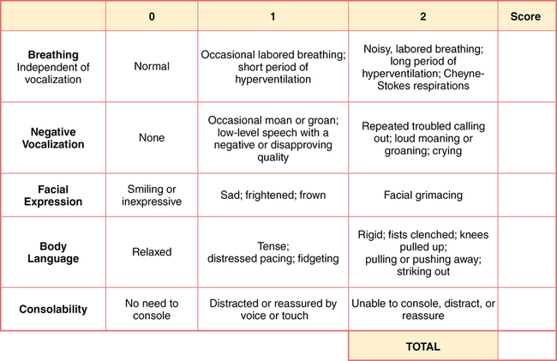
Riley Infant Scale - 3 months to 5 years

Slide 13
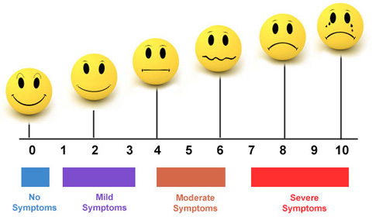
Wong-Baker Faces 5 years to adult

Slide 14
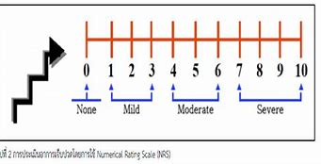
Numeric Sale – 10 years to adult

Slide 15
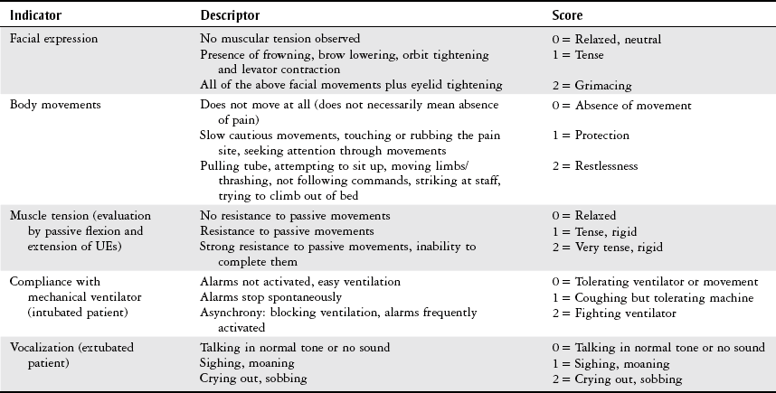
Critical care Observation Tool – noncommunicative adults

Slide 16
Pain Assessment in Advanced Dementia

Slide 17
Sedation Monitoring
Comfort Scale for mechanically ventilated patients
Ramsey scale for patients with non-opioid sedation
0-4 Sedation Scale for assessing patients on opioids

Slide 18
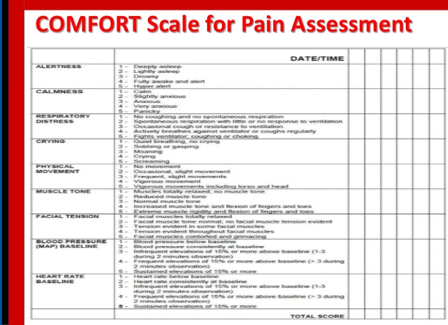

Slide 19
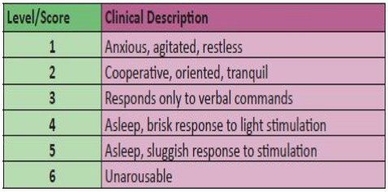
Ramsey Scale

Slide 20
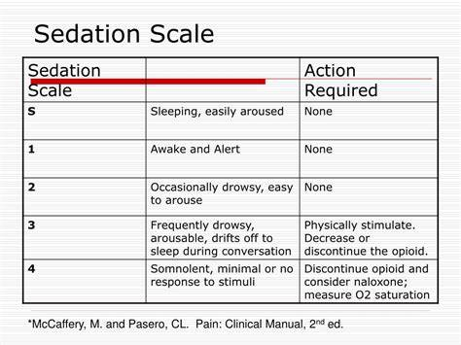

Slide 21
Non-Pharmacologic Pain Interventions
Repositioning
Massage therapy
Relaxation
Distraction
Music
Guided imagery
Acupuncture
Companionship
Exercise
Heat/cold application
Counseling- Pastoral, Psychosocial
Transcutaneous electrical nerve stimulation (TENS)

Slide 22
Pharmacologic Interventions
Medication must be ordered by the provider to address the level of pain the patient is experiencing –
Mild
Moderate
Severe
For uncontrolled pain a Pain Consult must be requested.
Patients requiring Patient Controlled Anesthesia (PCA) are referred to the Pain Management Service.

Slide 23
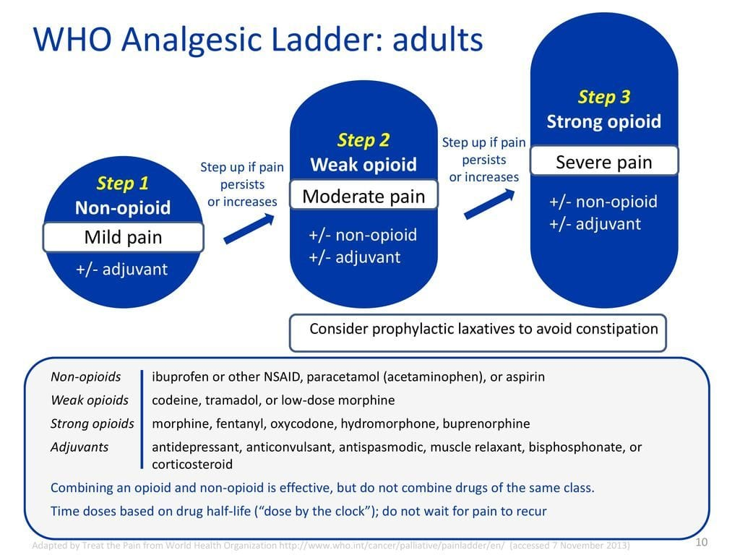
Pain Management

Slide 24
Role Responsibilities
Provider:
Assessment & reassessment of pain.
Order pain medication according to severity of pain – mild, moderate, strong.
Evaluate pain management outcomes and review/revise orders when necessary.
Request a Pain Management consult if indicated.
Educate patient and family regarding pain management initiatives.
Prescribe take home analgesics or alternate treatments at discharge.
Document pain management interventions and outcomes.

Slide 25
Role Responsibilities
Nurse
Assess pain severity & obtain a pain score.
Review medication order & administer medications based on pain severity.
Include non-pharmacologic interventions.
Monitor patient for effectiveness of pain management interventions.
Notify providers about challenges for effective pain management.
Update care plan as indicated.
Document interventions for pain management including:
assessment/reassessment
side effects noted
pharmacologic & non-pharmacologic interventions
level of effectiveness of the medications
issues reported to the provider and the resolution

Slide 26
Patient & Family Education
Include the following:
Patient’s acceptable pain level
Purpose & possible side effects of the medication
Treatment options for pain management – pharmacological/non-pharmacological, PCA pump
Safe use of opioid & non-opioid medications
When to take the medications at home
How to dispose of medications safely at home
Signs & symptoms to report
When to contact the provider

Slide 27
Scenario
Mr. Jones is post-op day 1. His numerical pain score at 6:00 pm is 9. Dr. Blue only ordered one pain medication prn.
What should Nurse Green do?
What should Nurse Green say to Dr. Blue?

Slide 28
Scenario
Dr. Blue refused to come to address the issue. What is the appropriate action for Nurse Green?
Administer the prescribed medication
Administer double the dose because the pain is strong
Escalate the issue to the ADN and service Attending
d. Do nothing and hand over this issue during the change of shift report

Slide 29
Scenario
Dr. Blue was instructed by the Attending Dr. Brown to revise the pain medication order immediately. The order was corrected and the medication was administered by Nurse Green at 6:35 pm. At what time must the pain re-assessment be done?
a. ____

Slide 30


