Slide 1
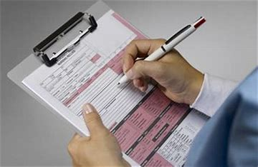

Documentation That Matters
Kathleen Farrell
EdD, MSN, BSN, BA, NPD-BC, CCE, C-EFM, RNC-OB

Slide 2
Documentation That Matters
Objectives
Define nursing documentation
Discuss the importance of documentation
Summarize key documentation elements
Review a documentation method that can produce quality results

Slide 3
Documentation That Matters
Definition
Any written or electronically produced information about a patient that describes the care discussed, planned, recommended, and/or provided to the patient and the subsequent outcomes.

Slide 4
The Joint Commission Standards
The hospital maintains complete and accurate medical records for each individual patient.
Entries in the medical record are authenticated.
Documentation in the medical record are entered in a timely manner.
The hospital audits its medical records.
The hospital maintains its medical records.

Slide 5
The Joint Commission Standards
The medical record contains information that reflects the patient’s care, treatment, and services.
The patient’s medical record contains documentation on any operative or other high-risk procedures and the use of moderate or deep sedation or analgesia.
Qualified staff receive and record verbal orders.
The patient’s medical record contains discharge information.

Slide 6
Documentation That Matters
Purpose:
To record all patient care activities
To facilitate communication/coordination of care
For reimbursement
Record of professional accountability
Proof of individualized care and the patient’s response
For continuity of care

Slide 7
Documentation That Matters
Purpose:
To facilitate change in the management plan
Accessible details in the event of litigation
To comply with requirements from professional, regulatory and legal agencies
To provide data for Research and Quality Management
Evidence that the standards of care have been met

Slide 8

Documentation Alert
If it is not written, it was not done

Slide 9

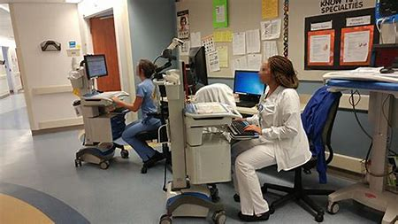
Documentation Tools
Documentation Tools
Electronic
Flowsheets
Progress Record
Checklists
Care Plans
Care Maps
Monitor Strips
Kardex

Slide 10
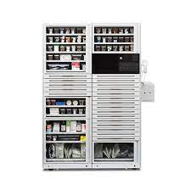

Slide 11
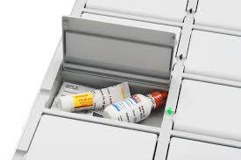

Slide 12
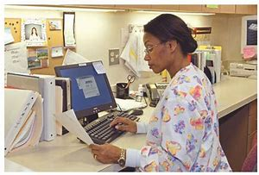
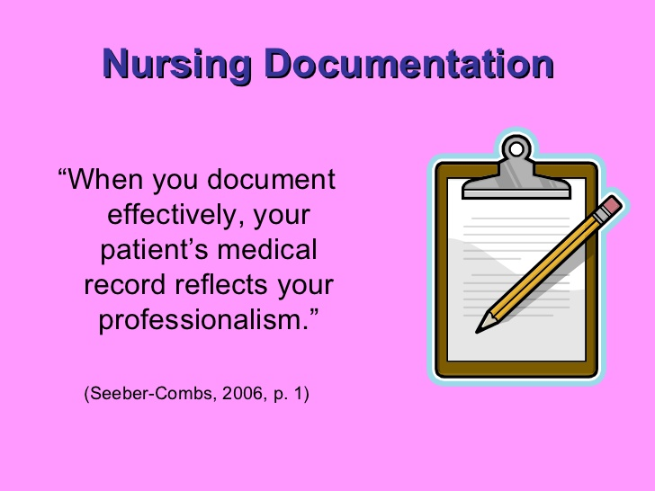
Documentation That Matters

Slide 13
Documentation That Matters
Factors that improve the quality of documentation:
Accuracy – what you see, hear, smell, feel, measure, and count
Relevance –record only data that is relevant to the
care of the patient
Completeness – include all required data and documentation forms
Timeliness – complete records within the time specified by the policies of the institution
Confidentiality – unauthorized access to Protected Health Information is prohibited by law

Slide 14
Documentation That Matters
When to Document
On admission
For patient care activities as indicated- before/during/after
If the patient refuses care
When there is a change in status and/or care activities
If there is an occurrence/issue
At transfer or discharge
After patient/family education

Slide 15
Documentation That Matters
What to Document
Observations/Assessments/Reassessments
All care provided by nurses and the interdisciplinary team
The treatment plan
Change in patient status
Response to treatment
Issues/incidents involving the patient and/or family members
Patient/family education and an evaluation of the process

Slide 16
Documentation That Matters
Considerations
The medical record (chart) is a legal document
No arguing or fighting in the medical record
The medical record must always be stored safely
Written consent is required to release medical documents
Correct errors according to the institution’s guidelines

Slide 17
Documentation That Matters
Do:
Check that you have the correct medical record before making entries
Write professionally – terminology, content, syntax
Enter data in the correct place (electronic records)
Date, time, sign every entry
Record conversations with care providers – name, content, response
Chart barriers/refusal of treatment and efforts to resolve the situation

Slide 18
Documentation That Matters
Do:
Avoid abbreviations. If required use only institution approved abbreviations
Follow the institution’s guidelines for “late entries” and “corrections”
Write legibly
When an entry continues to another page - sign the end of the first page and enter continued, date, time, and signature on the new page
Electronic entries -log off after entering data

Slide 19
Documentation That Matters
Do Not:
Document care before it is given – fraud
Alter the medical record – this is criminal
Block chart – enter care activities when provided
Enter care done by another nurse
Write imprecise descriptions, use a measurement

Slide 20
Documentation That Matters
Do Not:
Chart a symptom or complaint without stating what was done about it
Leave large spaces and blank lines between text
Copy medical records for yourself or family members this violates privacy rules

Slide 21
Incident/Occurrence Reports
A document that records an occurrence involving patients, visitors, and/or employees
Must be completed as soon as possible after the incident occurred
Be clear, concise, and factual
What happened
When
To whom
What was done about the situation
Notify nursing leadership & risk management immediately if completed
NEVER state in the medical record that an incident/occurrence report was completed

Slide 22
Documentation Methods
SOAPIE - Problem oriented charting
S Subjective | What the patient says
O Objective | Factual data – observed/measured
A Assessment | Conclusions based on objective & subjective data
P Plan | Management plan of care
I Intervention | Care given
E Evaluation | Outcome/responses to nursing & medical interventions

Slide 23
Case History
A 30 year old Black male was admitted because he was hit by a car while crossing the street. On admission the patient has a thigh high cast to his left leg, ecchymotic and bruised areas on face, hands, and chest. T 99, P 78, R 20, BP 140/90, O2 Sat. 99.
He is complaining of strong pain, also states that he feels sick and has a headache.

Slide 24
Documentation Method
S Subjective | Patient states “ I feel sick, I have strong pain and a headache.”
O Objective | T 99, P 78, R 24, BP 140/90, O2 Sat 99.
A Assessment | Numeric pain score 10/10. Cast dry and intact. Toes warm to touch, small amount of swelling noted. Ecchymotic and bruised areas on face, hands, and chest dry. Swelling on left side of the face. Increased respiratory rate. Elevated BP.
P Plan | Elevate the left leg on a pillow. Medicate for pain. Neuro checks q 30 mins. Observe for signs of respiratory distress. Patient education: signs and symptoms to report –respiratory distress, CNS changes, pain, cast discomfort. Monitor BP.
I Intervention | Elevate leg. Medicate for pain. Neuro checks. Request MD to come and evaluate the patient.
E Evaluation | Numeric pain score 3/10. Neuro checks within normal limits. R 20.

Slide 25

Documentation That Matters

Slide 26
References
American Nurses Association. Nursing: Scope and Standards of Practice, 4th Edition. Silver Spring, MD: American Nurses Association 2021.
ANA’s Principles for Nursing Documentation: Guidance for Registered Nurses. American Nurses Association, Silver Spring Maryland, 2010.
Standards for Joint Commission Accreditation and Certification. https://.www.jointcommission.org/standards

