Slide 1
MISSION POSSIBLE: EXCELLENCE IN PROFESSIONAL NURSING PRACTICE
Dr. Faruk Umar Abubakar
Registrar/CEO Nursing and Midwifery Council of Nigeria
@ CONFERENCE ORGANIZED BY BABCOCK UNIVERSITY

Slide 2
OUTLINE OF THE PRESENTATION
Introduction
Concept of Nursing Excellence
Components Associated with Nursing Excellence
Principles of Everyday Excellence
Essential Elements that Contribute to Nurturing Excellence in Nursing Practice
Cultivating Compassionate Care: The Heart of Nursing
Promoting a Culture of Well-Being
Conclusion

Slide 3
Introduction 1/1
Nursing, often described as the heart of healthcare, is a dynamic and evolving profession that requires a delicate balance of compassion and expertise.
Nurturing excellence in nursing practice goes beyond the acquisition of technical skills.
It involves fostering a culture that values continuous learning, empathetic care, and a commitment to the well-being of individuals and communities.

Slide 4
Concept of Nursing Excellence
Nursing excellence
is about developing and advancing strong nurse leaders, who are then able to advocate for their patients and nurse peers.
It requires a structure within the organization that supports shared governance and involved in decisions making, measuring transparency and establishing performance benchmarks
Promoting autonomy for nurses inside that shared governance framework

Slide 5
Nursing Excellence Cont’d
Healthcare has long valued the patient, striving for good clinical quality outcomes.
Patient safety is essential to clinical quality outcomes, can hesitate to human error in the most unfortunate cases, despite best efforts
Optimizing first-class working environment in ensuring excellence that includes the leadership development plan and providing incentives to professionalism

Slide 6
Nursing Excellent Cont’d
Nursing excellence can be defined in various ways, but it generally refers to the high level of quality care, professionalism, leadership, and commitment that nurses demonstrate in their practice.

Slide 7
KEY COMPONENTS ASSOCIATED WITH NURSING EXCELLENCE 1/1
Clinical Competence:
  It involves possessing a high level of clinical knowledge, skills, and expertise
  Evidence-based practice for professional development.
Compassionate Care:
  Demonstrate empathy, and respect
  prioritize the holistic needs of the individual

Slide 8
COMPONENTS ASSOCIATED WITH NURSING EXCELLENCE 1/2
Critical Thinking and Problem-Solving:
    Think critically, analyze situations, and make sound decisions
    Proactive in identifying and addressing issues
Effective Communication:
  Involves clear and effective communication
  Good communication skills are essential
    for building trust,
    fostering collaboration, and
    ensuring continuity of care.

Slide 9
COMPONENTS ASSOCIATED WITH NURSING EXCELLENCE 1/3
Advocacy:
patients' rights, preferences, and best interests.
  Serve as a voice to ensure that patients receive the highest quality of care.
Leadership and Collaboration:
  Ability to lead by example,
  mentor others, and
  join forces effectively to improve patient care outcomes.

Slide 10
COMPONENTS ASSOCIATED WITH NURSING EXCELLENCE 1/4
Commitment to Professionalism:
  Adhere to high ethical standards,
  Maintain confidentiality, and
  Demonstrate integrity in all aspects of their practice.
  Take responsibility for their actions,
  Obtain feedback for continuous improvement

Slide 11
PRINCIPLES OF EVERYDAY EXCELLENCE 1/1
The framework of everyday excellence intends that nurses are empowered to enact the professional values, best practices, and caring spirit of geriatric nursing when it is integrated into and supported by the structures and processes of a long-term care organization.
An underlying assumption of this framework is that the RNs who work in nursing homes are capable of creating, implementing, and sustaining site-specific professional practice models based upon the eight principles of Everyday Excellence:

Slide 12
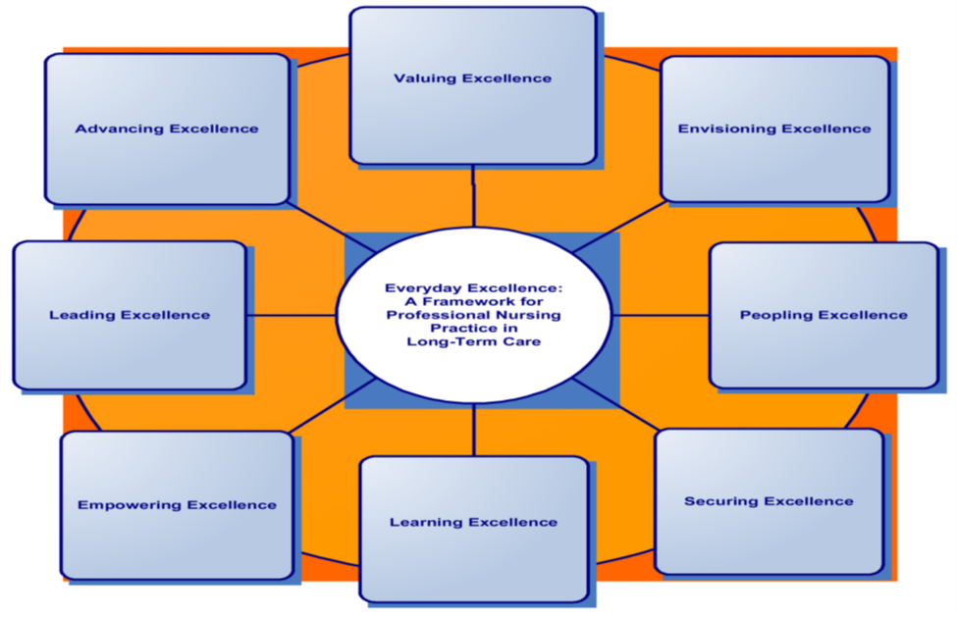

Slide 13
PRINCIPLES OF EVERYDAY EXCELLENCE 1/2
Principle 1: Valuing Excellence
  Demonstrate that we measure the meaningful work we do as professional nurses
Principle 2: Envisioning Excellence
  Shared on philosophy of caring,
  Recognized nursing standards,
  Responsive to resident needs and
  Strategic goals of the organization.

Slide 14
PRINCIPLES OF EVERYDAY EXCELLENCE 1/3
Principle 3: Peopling Excellence
  Consider geriatric nursing a desirable, Enriching, and challenging clinical specialty and demand positions of responsibility,
  leadership, and professional Nursing care settings.
Principle 4: Securing Excellence
  Professional nurses secure excellence in our workplaces by creating care settings that all people experience as healthy, respectful, and safe.

Slide 15
PRINCIPLES OF EVERYDAY EXCELLENCE 1/3
Principle 5: Learning Excellence
  Thrive in intellectual climates where this specialized knowledge forms the basis for excellence in professional nursing practice .
Principle 6:
Empowering Excellence
  Empower and respect ourselves as a member of interdisciplinary healthcare team to achieve excellence in resident care.

Slide 16
PRINCIPLES OF EVERYDAY EXCELLENCE
Principle 7:
Leading Excellence
  Create organizational structures that facilitate collaborative practice
  Cross-organizational initiatives to achieve excellence in Nursing Care.
Principle 8:
Advancing Excellence
  New visions of excellence through a commitment to research
  Application of technological innovations and evidence-based practices,
  Dedication to social policies that achieve equitable, high quality, and compassionate heath care for all.

Slide 17
Essential elements that contribute to nurturing excellence in nursing practice 1/1
Continuous Learning:
Constantly advancing with new medical discoveries, technologies, and treatment modalities.
  Commitment to continuous learning.
  Abreast of the latest research
  Professional development programs
Professional Development Opportunities:
  prioritize ongoing professional development opportunities for nurses.
  Enhance clinical skills to foster leadership and critical thinking.

Slide 18
Essential elements that contribute to nurturing excellence in nursing practice 1/2
Encouraging Higher Education:
  Pursuing higher education elevates the overall standard of nursing practice.
Mentorship Programs:
  creates a supportive environment for less experienced nurses.
  Share their knowledge, provide guidance, and instill a sense of confidence in their mentees.

Slide 19
Cultivating Compassionate Care: The Heart of Nursing
The human touch and empathetic connection between a nurse and a patient are powerful healers.
Nurturing compassion involves:
  Empathy Training:
  Develop the ability to understand and share the feelings of their patients.
  This humanizes the care process and fosters trust.

Slide 20
Cultivating Compassionate Care: The Heart of Nursing
Patient-Centered Care:
  Encouraging and ensures that care is tailored to the unique needs,
  preferences, and values of each individual.
  involving patients in decision-making, and acknowledging their emotional well-being.
Recognition and Appreciation:
  Acknowledging contributes to a positive work environment.
  Feeling valued and recognized motivates nurses to deliver care with passion and dedication.
Embracing Innovation and Technology
  The landscape of healthcare is continually shaped by technological advancements.
  Involves embracing innovation and integrating technology to enhance patient care.

Slide 21
Cultivating Compassionate Care: The Heart of Nursing
Training in Health Informatics:
    ensures that nurses can effectively navigate electronic health records (EHRs) and
    leverage technology to streamline processes.
Telehealth Integration:
    Equips nurses to provide care remotely
    Adapt to evolving models of healthcare delivery.
Simulation Training:
    Allow nurses to practice their skills in a controlled environment,
    Ensuring readiness for real-life scenarios.

Slide 22
Promoting a Culture of Well-being
Nurses are dealing with high-stress situations and demanding schedules which involves recognizing the importance of nurse well-being.
  Flexible Schedules:
    Achieve a better work-life balance
    Reducing burnout and enhancing overall job satisfaction.
Mental Health Support:
    promotes emotional well-being among nurses
    cknowledging the challenges they may face in their roles.
Physical Well-being Programs:
    Ensures that nurses are physically equipped to handle the demands of their profession.

Slide 23
CONCLUSION
In conclusion, nurturing excellence in nursing practice requires a holistic approach that integrates continuous learning, compassionate care, technological proficiency, and a focus on well-being.
Nurses play a pivotal role in shaping positive patient outcomes and contributing to the overall success of healthcare systems.
Investing in the professional development of nurses the quality of patient care but also honor the dedication and compassion inherent in the nursing profession.

Slide 24
CONCLUSION
Overall, nursing excellence is about striving for the highest standards of care, constantly seeking opportunities for growth and improvement, and making a positive impact on the lives of patients and the healthcare community.
Nurturing excellence in nursing is not just a goal; it is a commitment to creating a healthcare environment where both nurses and patients thrive

Slide 25


